Slide 1


What’s in a Name?
Gabriel Alves
Scott Boxberger
Erik Figge
Rajeev Kulshrestha

Slide 2
PROJECT OBJECTIVE
Our project will examine trends of baby names over the past century. We’ll examine change in gender of names over time; difference in popularity of names by state/region compared to national; influence of the “famous people” (e.g., sports, entertainment, or any other trigger, etc.) on names; ethnicity/origin changes over time by state/region; and one-time names that pop up (minimum 5 for our dataset) with an investigation of reason for that name selection. We will use an existing dataset for names by state and time. We will attempt to acquire a dataset that identifies ethnicity of first names. And we will attempt to identify correlation between popular celebrities and increase in name popularity.
If time allows we will also look at fun presentation methods and other usages of the data (e.g., utilizing a twitter bot).

Slide 3

What questions did we address?
How have baby names changed in popularity over the years?
Is there a difference in Male vs Female trends?
Are there state/regional differences in name popularity?
Have names shifted in gender popularity?
Does Pop Culture, Sports, etc. influence name selection?

Slide 4
Data Cleanup
Source: Kaggle.com dataset (extracted from data.gov, via US Social Security Administration)
National File
Male
Female
State File
Male
Female

Slide 5
DISCOVERY PHASE
Researched multiple websites like Kaggle.com, DataWorld.com, Google Cloud for datasets which are source for US baby names data. Every source we found was sourcing data from US Social Security Administration(SSA) website.
While researching data we found that SSA provides two data files one by name and year and second one with name, year and state.

Slide 6
Requirements phase
Breaking the project objective into workable requirements for the team members to work on work distributed objectives towards the single goal of achieving the objectives within the limitation of time and resources.
Collecting latest raw data from US SSA website.
Best practices for working on raw data files and creating clean data sets for the baby names based on the various ways like name, year of birth, sex, number of births and state of birth.
Setting the analysis objective for each team member based on defined objectives, choice and interest.

Slide 7
Design / coding /analysis phase
Programmatically downloading the raw data files for US Social Security Administration(SSA) website.
Defining the data schema for the dataframes:
yob = a dataframe with each record comprising a unique name, sex and year. Length: approx. 1.76 million records; pickle = ~100 MB
name String
sex M or F
births Number of birth with that name of that sex during that year;
names with fewer than 5 births in a given year are omitted due to
privacy concerns
year 1880-2017
pct Percentage of births of that sex during that year with that name (float)
ranked Rank of number of births of that name among all births of that sex during that
year

Slide 8
names = a dataframe with each record comprising a unique name and sex, with data for individual years discarded but summary and additional data added. Length: approx. 101,000 records; pickle = ~ 7 MB
name Same as in df
sex Same as in df
year_count Number of different years in which that name appears in dataframe, from 1 to 133.
year_min First year name appears in database
year_max Last year name appears in database
pct_sum Sum of pct field for that name for all years. Not a statistically meaningful number
(because the underlying distribution of names varies from year to year),
pct_max Maximum value in pct field for all years, indicating the most popular that name has ever been in the database.

Slide 9
years = a dataframe with each record comprising a unique year, with individual name data discarded but summary and additional data added. Length: 136 records; pickle = ~ 8 kB
year Same as in df
births_f Number of female births during that year
births_m Number of male births during that year
births_t Total number of births during that year
new_names Number of names that appear for the first time during that year
unique_names Number of different names that appear during that year
sexratio Number of boys born per hundred girls
Steps to create the data frame:
Read individual files, yob1880.txt, yob1881.txt, etc. and assemble into a dataframe
Add column 'pct': the number of births of that name and sex in that year divided by the total number of births of that sex in that year, multiplied by 100 to turn into a percentage and reduce leading zeroes.

Slide 10
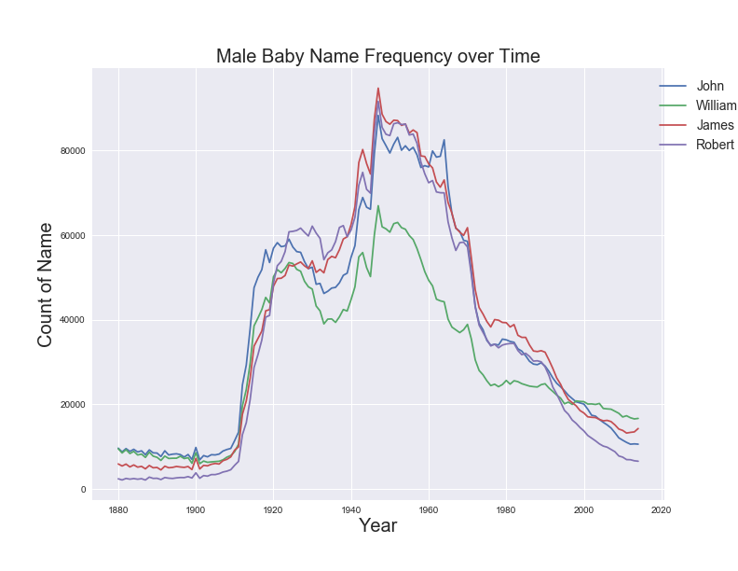
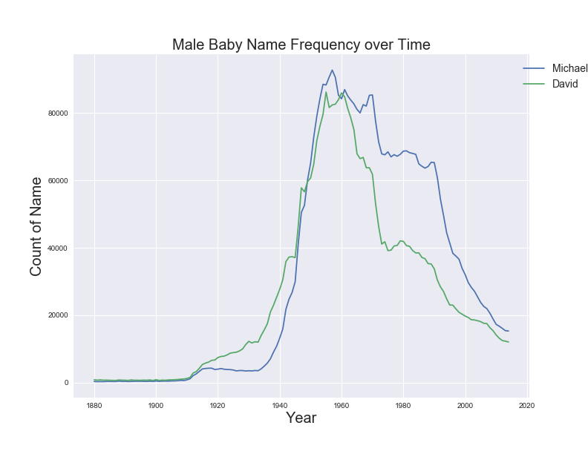
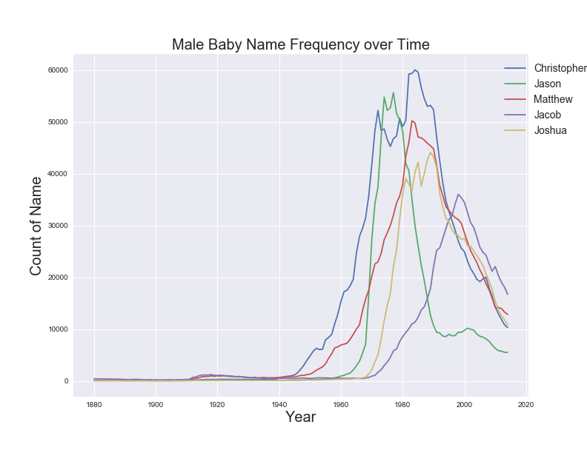
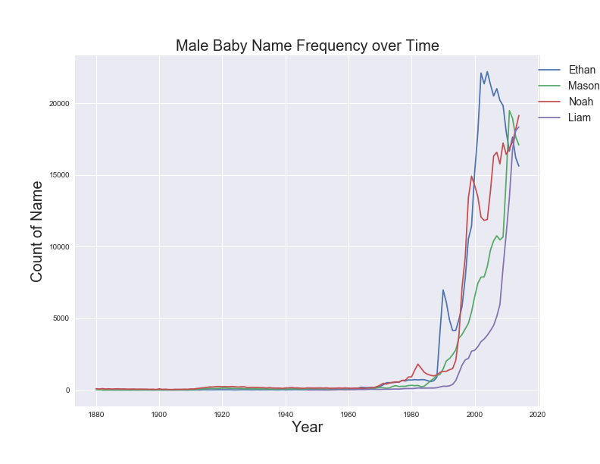
Baby Name Popularity over Time (Male)
Top 3 in any Year
15 Male Names
Longer popularity duration in early years
More volatile in later years

Slide 11
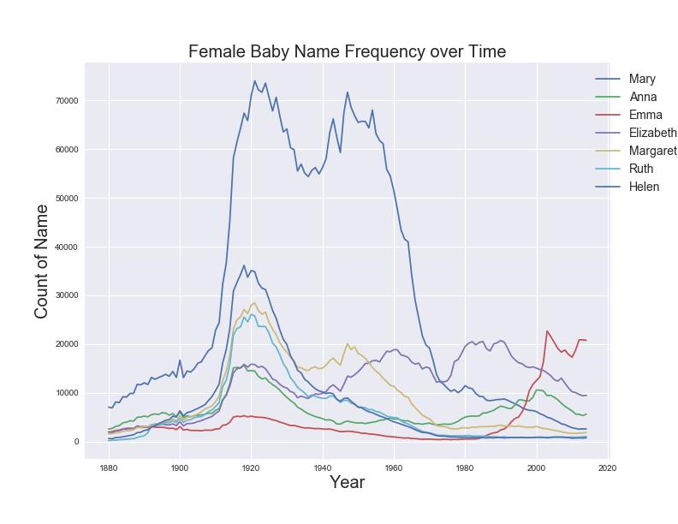
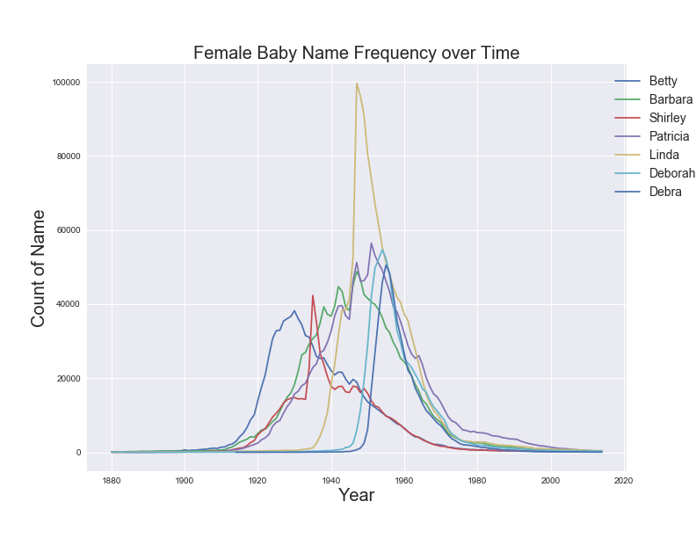
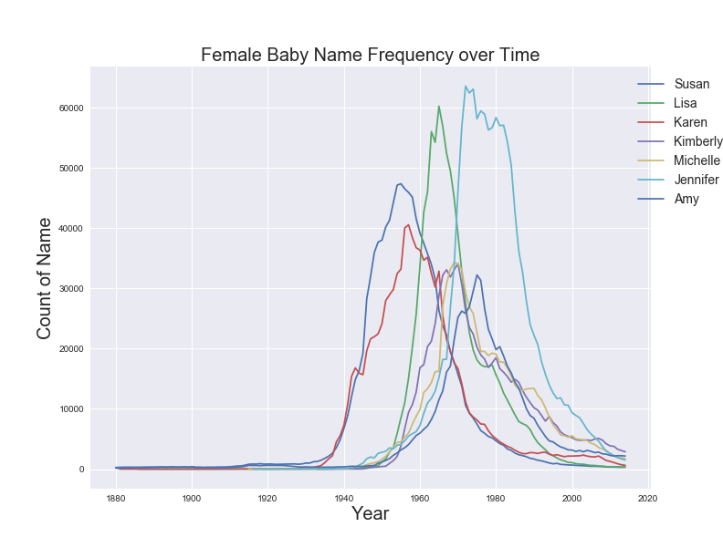
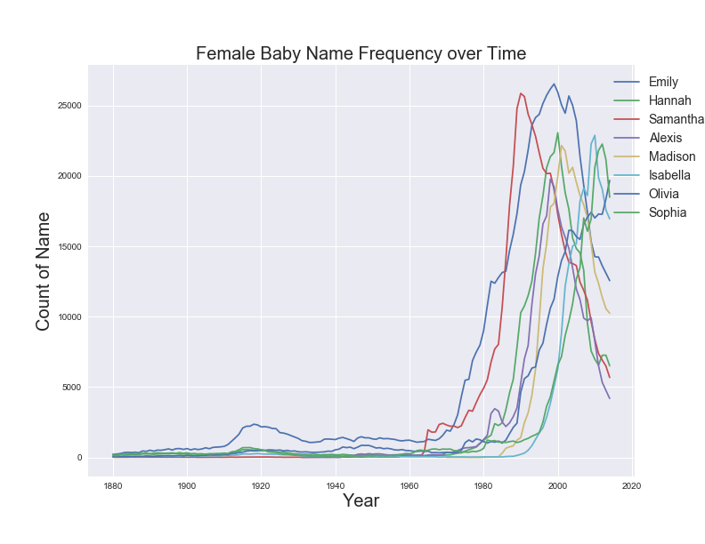
Baby Name Popularity over Time (Female)
Top 3 in any Year
37 Female Names (over twice as many as male)
Longer popularity duration in early years
More volatile in later years
Let’s Talk About Linda

Slide 12
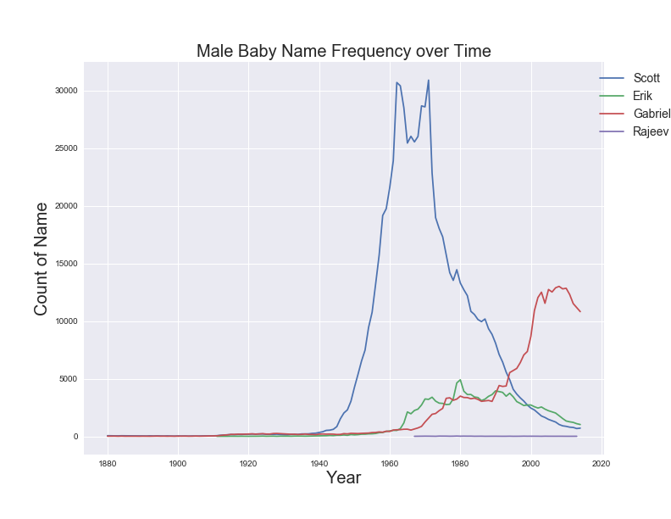
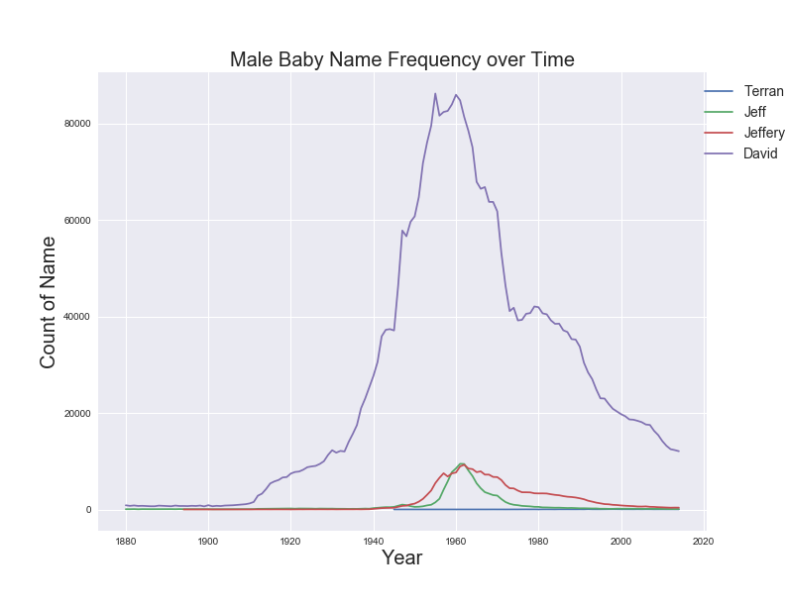
Team/Instructor Name Popularity

Slide 13
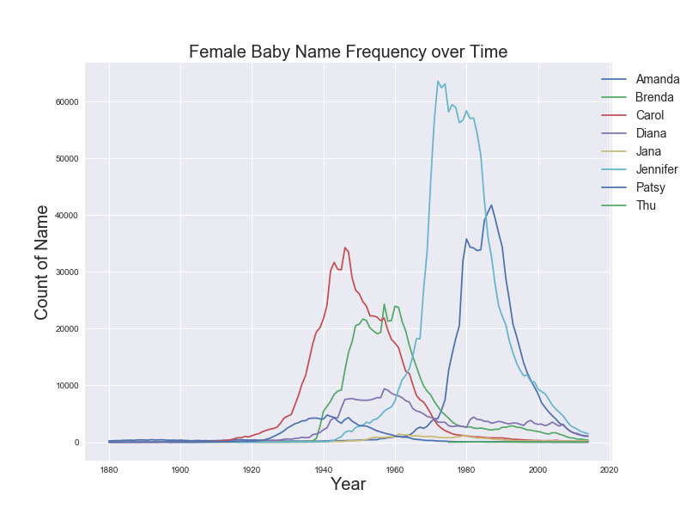
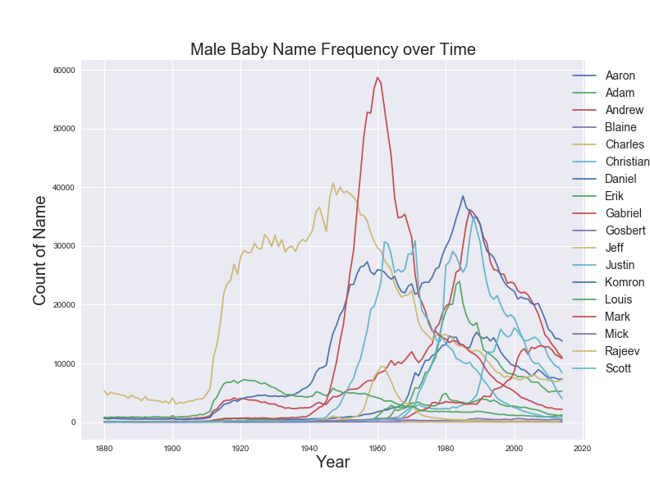
Class Name Popularity
Twitter: @RocChalkChicken
#Name_Male_XX_19XX or #Name_Female_XX_19XX
#Scott_Male_KS_1969

Slide 14
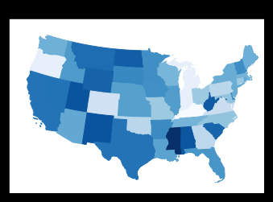
STATES COLORED BY BABY NAME UNIQUENESS

Slide 15
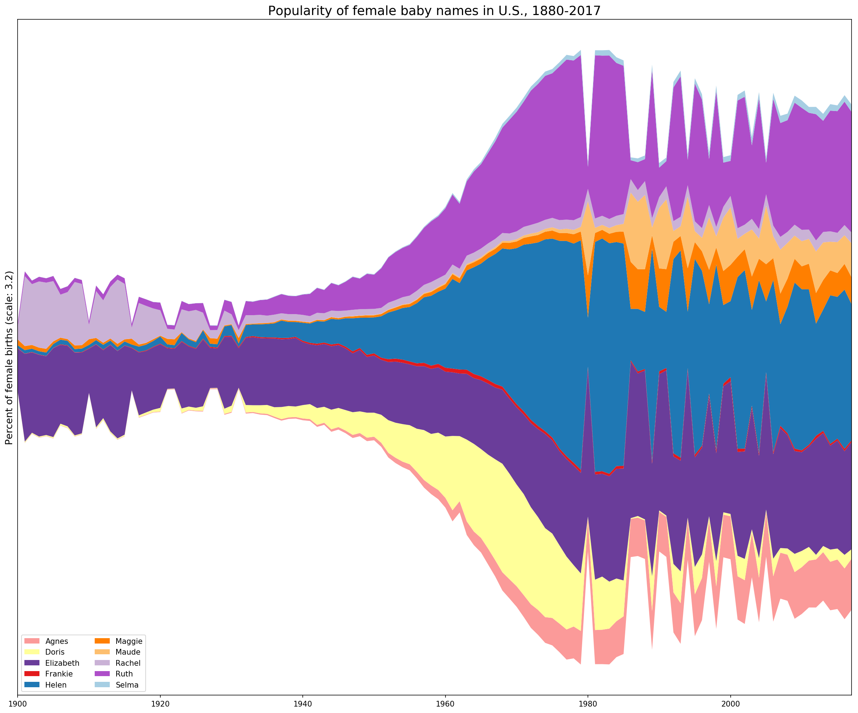

Slide 16
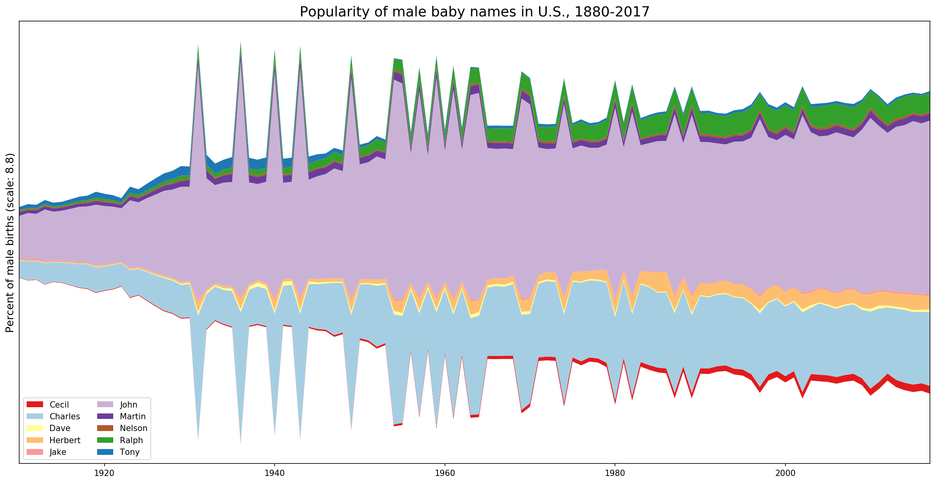

Slide 17
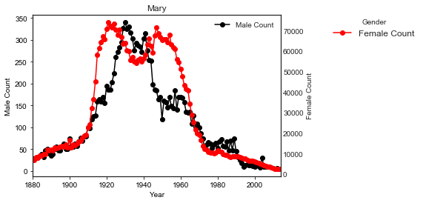
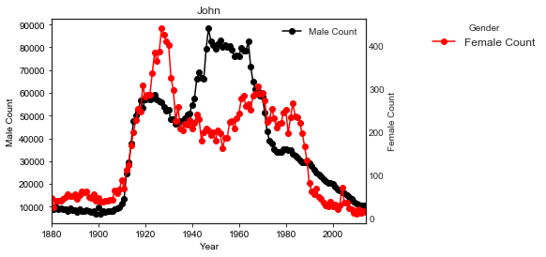
Mary vs. john

Slide 18

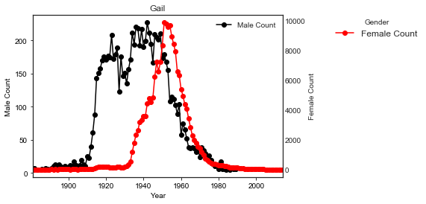
Gail
Gail Russell, an American film and television actress.

Slide 19
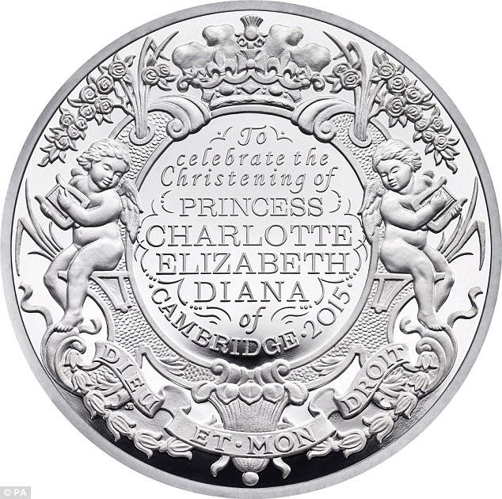
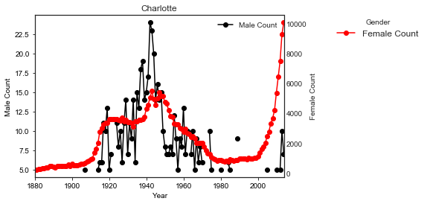
Charlotte
The birth of princess Charlotte of Cambridge has a massive influence.

Slide 20
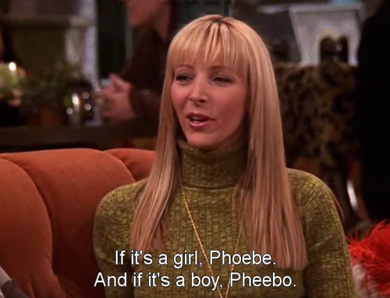
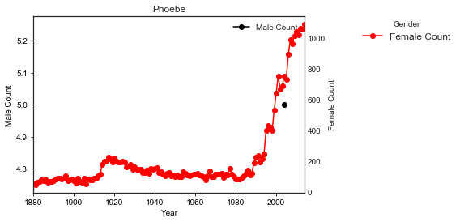
Phoebe
TV Show’s influence
on babies’ names;
Friends started in 1994.

Slide 21


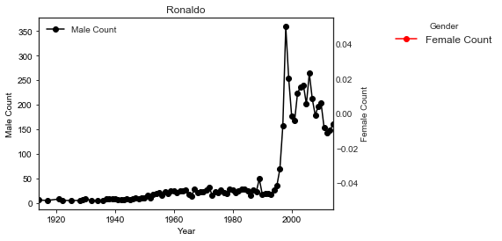

Ronaldo
Mainly after the World Cup
in 1994 in the United States, Ronaldo’s names started
to appear.

Slide 22
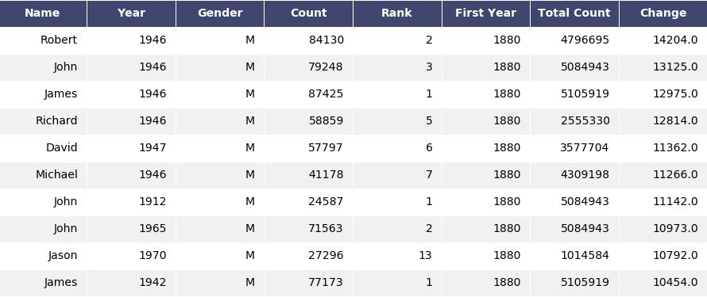
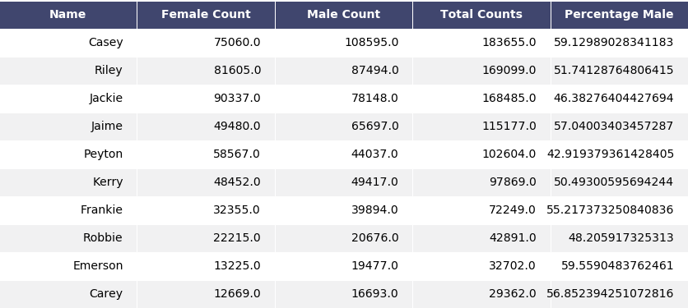
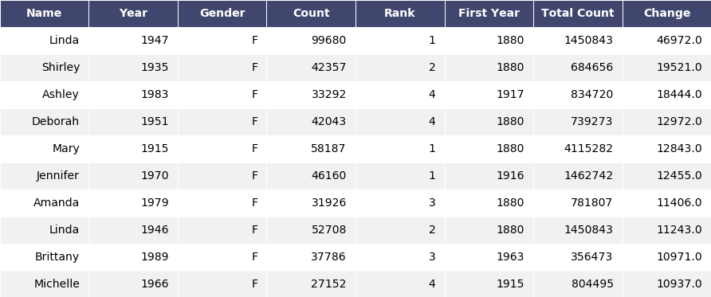
Choosing the names
Gender Neutral Names
Spotting Spikes in the Data

Slide 23
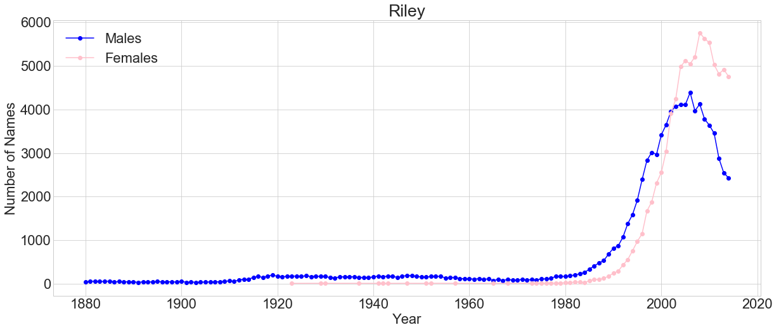
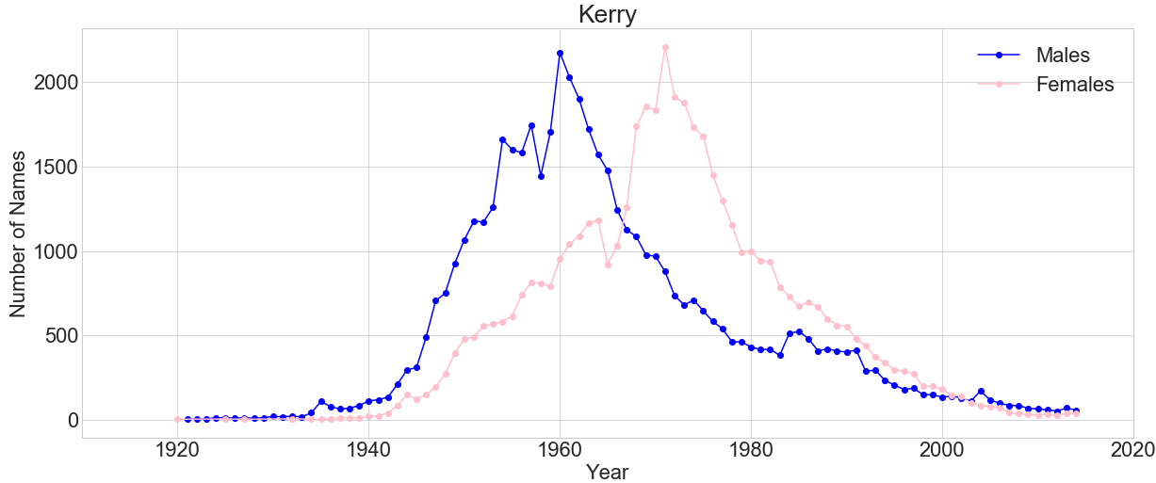
Names and Gender Distribution
Similar Counts
Riley 51.74% Male
Kerry 50.49% Male
Similar distribution over time
No obvious cultural influences

Slide 24
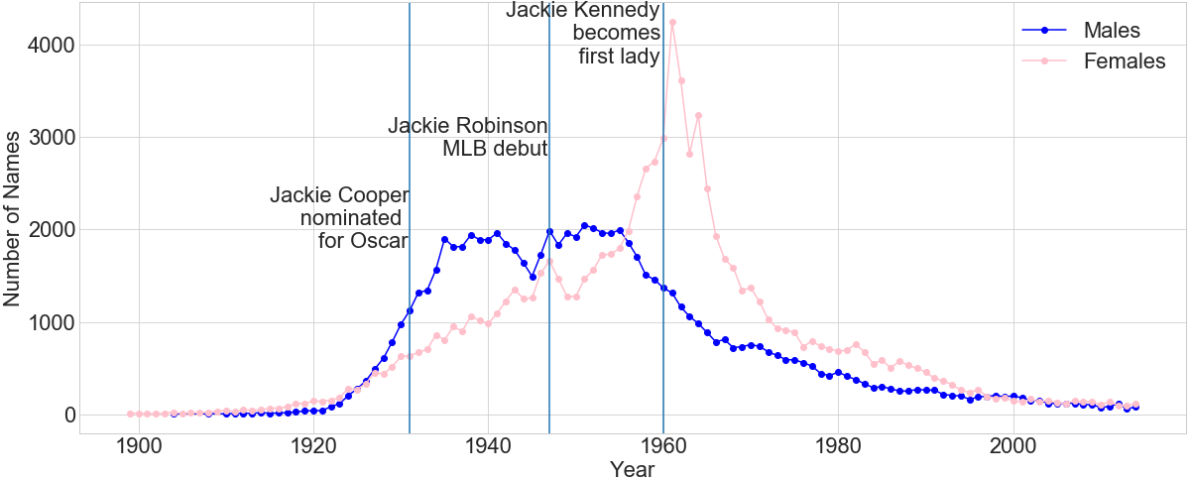
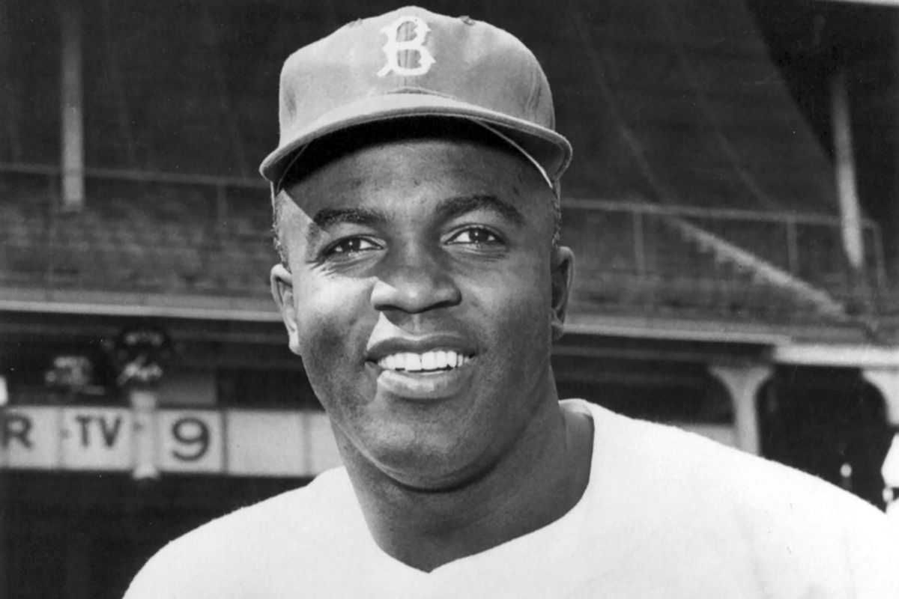
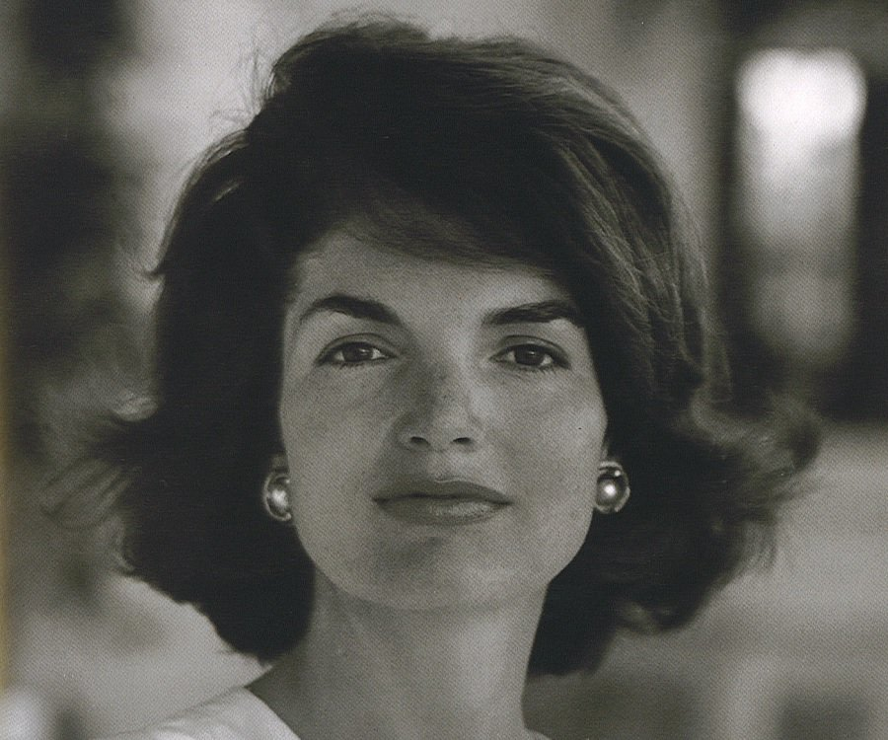

Jackie and Cultural Influence
- Possible increases related to celebrities
- Relationship between male and female naming patterns

Slide 25
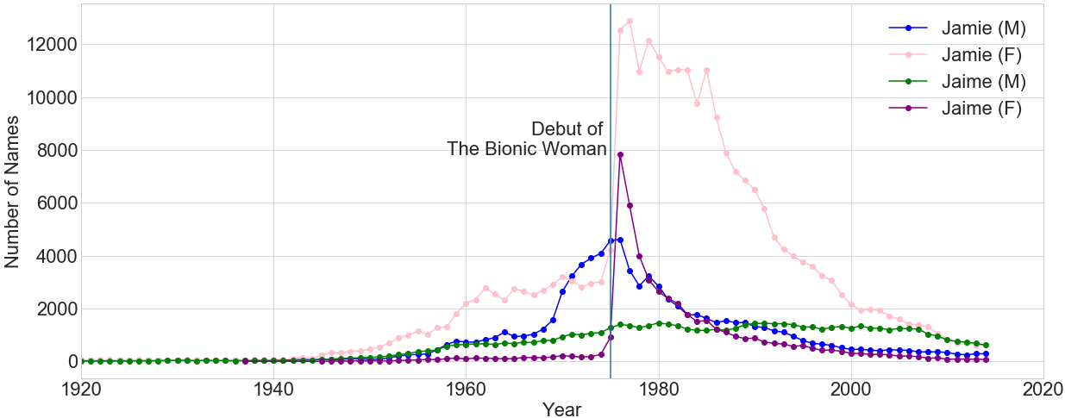

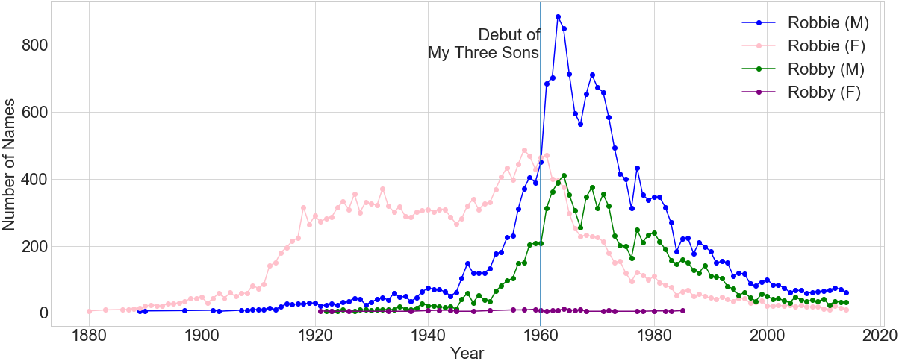


TV Influences
Jaime Sommers
Robbie Douglas

Slide 26
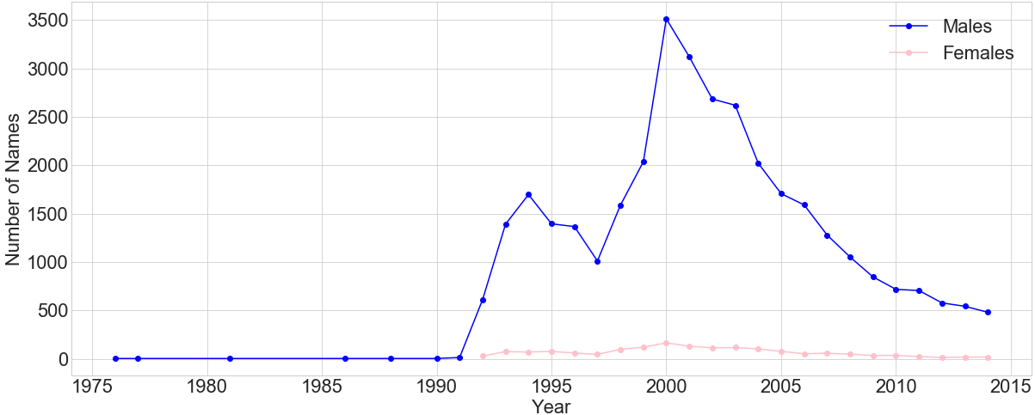

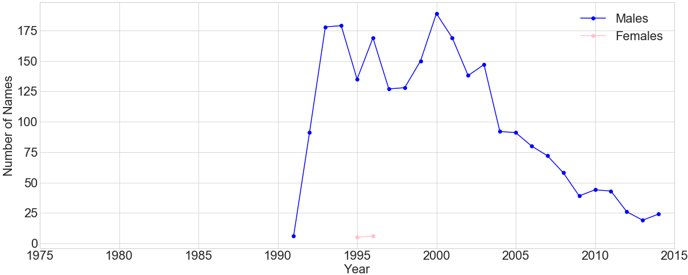
Jalen Rose
”My biological father’s name is James, my uncle’s name is Lenard, J-A-L-E-N, that’s where the name comes from.” – Jalen Rose
National
State of Michigan

Slide 27
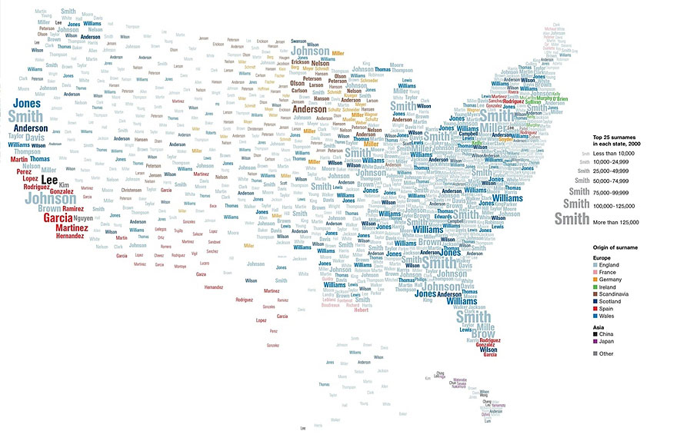
If we had two more weeks/Months/years…
We would look at ethnicity and how it relates to name:
Need dataset relating names to ethnicity
Possibly need last names
Have this data at the state level
Track names (first and last over time and space)
Solve the challenges of working with state data:
Plot the movement of first names over states through time
Perform regional analysis
Perform regression on name movement to predict future movement
Update name data with the most recent years to find current trends

Slide 28
Appendix

Slide 29
iPython Notebooks

